Slide 1

Instruction Manual for the CQR DENTURE Technique

Slide 2
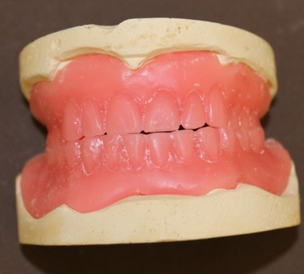
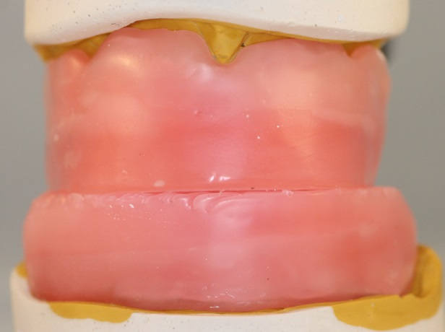
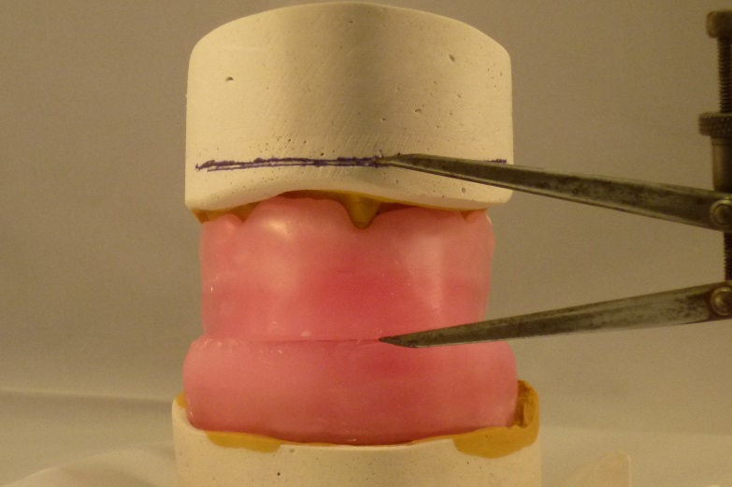
LABORATORY PROCEDURES
The recording of the patients neuromuscular centric neuromuscular position (NCP) of the jaws position can be achieved by different methods. Remember: Not Centric Relation. Opposite is the wax copy technique. (Fig 1) this is just one of the ways to record NCP. The most common is the bite registration method and this like the wax copy technique can be used to get the neuromuscular centric position. Whichever technique is used, it is important that you extend your occlusal plane line to at least the premolar region on both sides. This is to align the posterior part of the plates in the correct plane for the posterior teeth. It is worth pointing out that the CQR technique doesn’t restrict the clinician in their choice of techniques or materials , especially the teeth they would like to use.
Fig 1
A simple hinge or A-line articulator is used to articulate the registration components, remember these could also be any bite registration technique. (Fig 2)
Fig 2
For all methods of recording the neuromuscular centric position, you will need to mark on the models the occlusal plane line by using your dividers. (Fig 3)
Fig 3

Slide 3
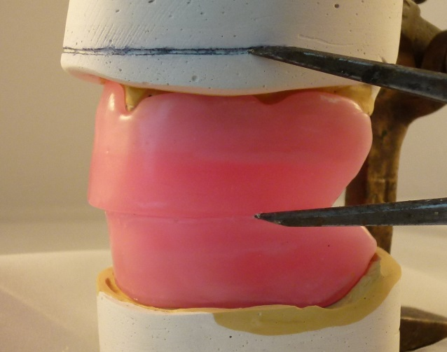
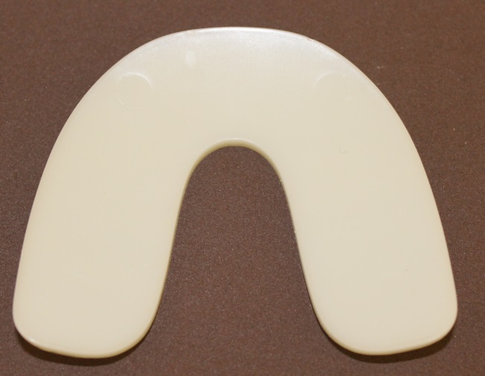
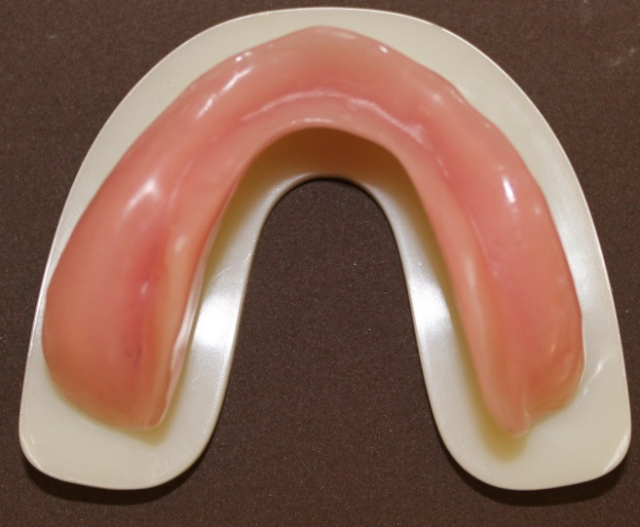
LABORATORY PROCEDURES
Before you go to the next stage, it is recommended to have a occulsal plane extending to the posterior region. (Fig 4) The reason being that it will help when you do the next part, when adding the occlusal plate to do the patients dynamic functional movements. If you are using other bite registration techniques, the same process is required.
Fig 4
In the picture opposite (Fig 5) you will see the oversized occlusal plate, with the new dynamic, parabolic compensating curves already built.
Fig 5
The denture is placed on the plate, (Fig 6) finding the best position for a marker to scribe around the denture teeth. This to give an idea of the shape the occlusal plate has to be for this patients alveolar ridges. If you are using wax copies or registration rims the principle is the same. Make sure that the plates width is not too thin, widen if you feel you will need more surface area to record the dynamic movements, especially in the posterior region.
Fig 6

Slide 4
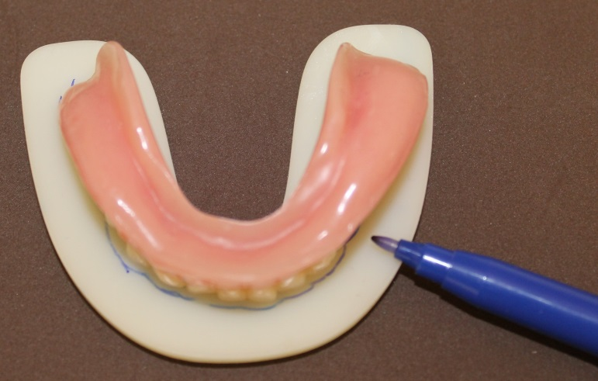
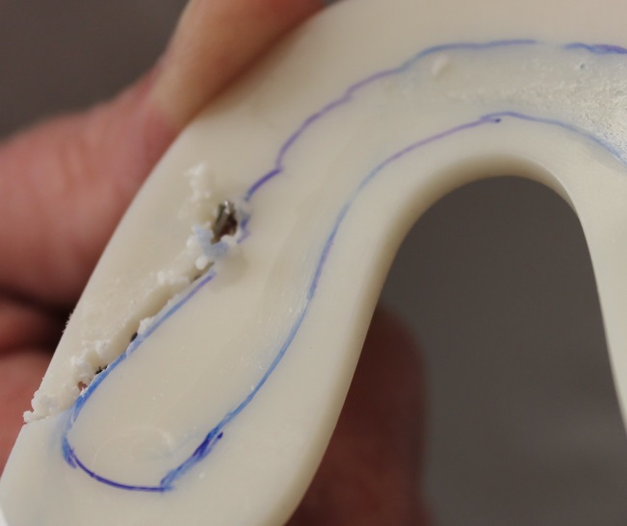
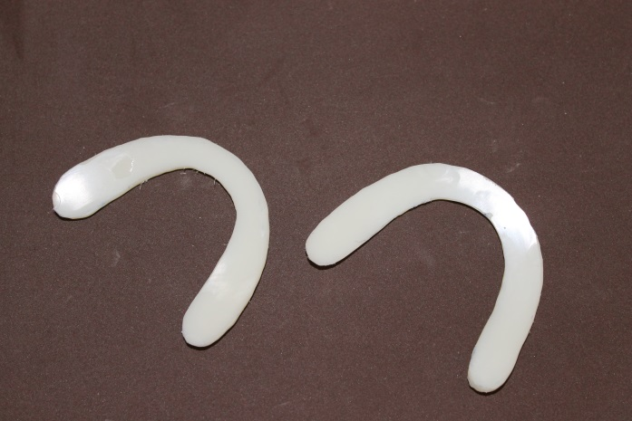
LABORATORY PROCEDURES
In Fig 7, the shape of the occlusal plate is marked using the patients existing denture as illustrated. A bite registration rim is also very acceptable to do the same thing.
Fig 7
The markings that have been taking from the denture etc., and if you feel that they need to be a little wider or a little longer then it is best to alter the drawing accordingly. Once you are happy you cut away the excess plastic using a bur or large grinding wheel. The same process will be done for the upper arch. Fig 8
Fig 8
The edges are smooth using a cross cut bur or silicone rubber cone, removing any parts that will effect the smooth moving of the plates when they come together. Fig 9. The lower occlusal plate can be trimmed a little more in the lingual/anterior region if needed, so to give the patient a little more tongue room for comfort.
Fig 9

Slide 5
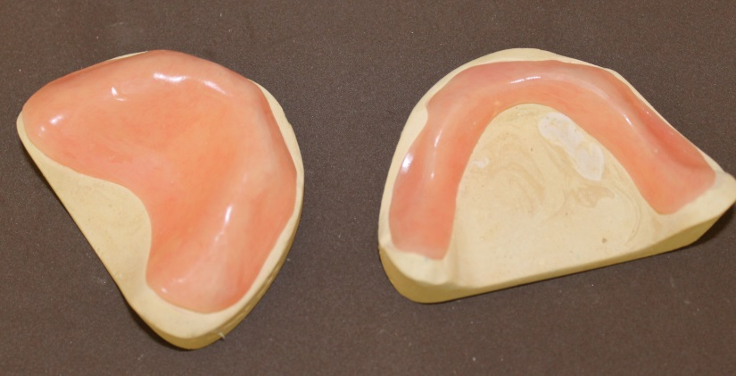
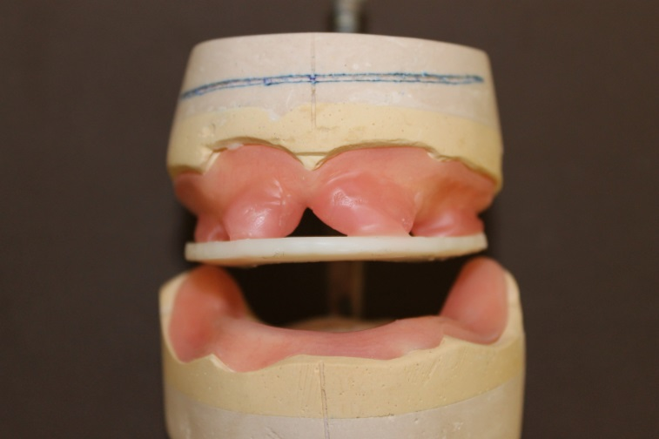
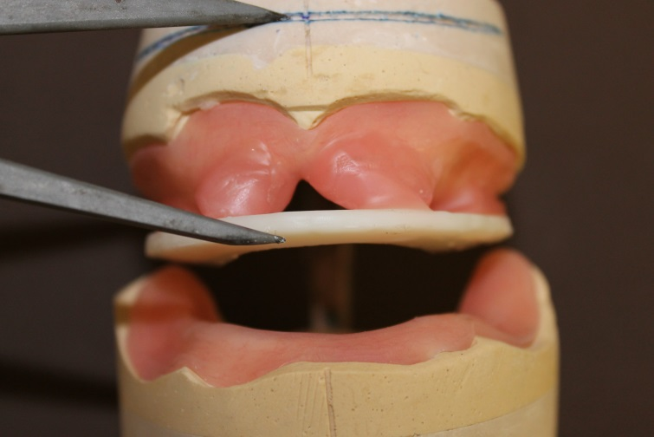
LABORATORY PROCEDURES
To go to the next stage it is recommended that you make acrylic base plates, as these will give a sturdier base, as we are now going to record the patients dynamic function. Fig 10
Fig 10
In Fig 11, you will see that wax has been added to the base plate in four areas. The wax is soften and then the plates is positioned. Making sure that the rim is over the upper ridge.
Fig 11
In Fig 12, you will see the use of the extended occlusal plane line, because you can use the dividers to check the plate has been positioned correctly.
Fig 12

Slide 6
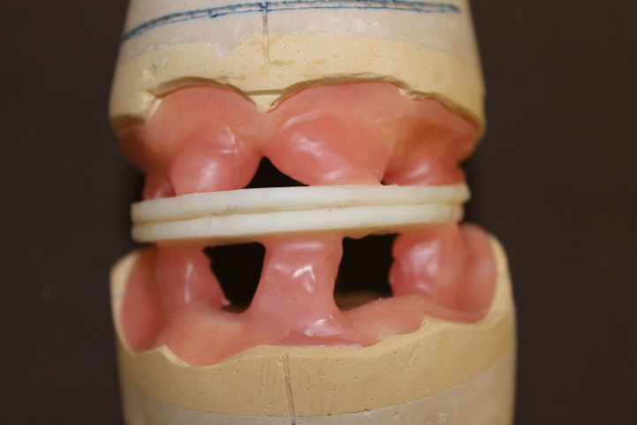
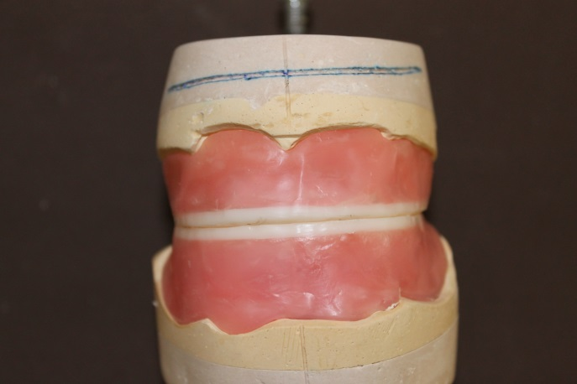
LABORATORY PROCEDURES
In Fig 13, the lower occlusal plate is now put into position, making sure it is place over the patients lower alveolar ridge and is a close fit to the upper plate. You do not want to see any daylight between the two plates. One tip is to seal the plates together with some wax, soften the wax on the lower plate and then close the articulator to position the lower plate. Allow the wax to harden an then separate the two plates.
Fig 13
The final waxing up process can take place. The dynamic occlusal rims are now ready to be used in the office/surgery for the next appointment. Fig 14
Fig 14

Slide 7
CLINICAL PROCEDURE
Dynamic Bite Clinical stage.
Procedure on how to record the patients neuromuscular centric occlusion bite record.
1. The shoulder tap is a guide to intensity and speed of the “tap-tap”. First is light so the muscles can find their “home”. The second is firm or hard to determine the location of the contacts, interfering or not. This results is a musculo-skeletal dynamic and locates the proper NMCO. So, it is not “Tap-Tap”, but “tap-TAP”, very light and then very firm.
2. In natural dentition, the patient’s eyes almost always track to the interfering side, left or right and to the upper or lower. If the perceived contact is on the lower right they will look right and down. With the dynamic plates they will probably just look to the effected side, upper or lower may not perceived.
When the occlusion is correct and stable, their eyes will be centred and stable.

Slide 8
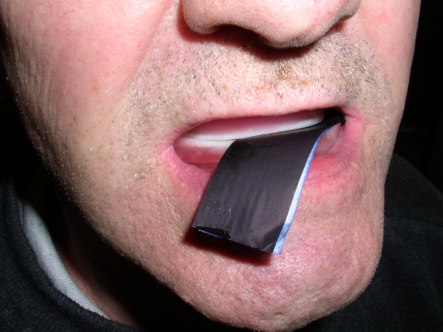
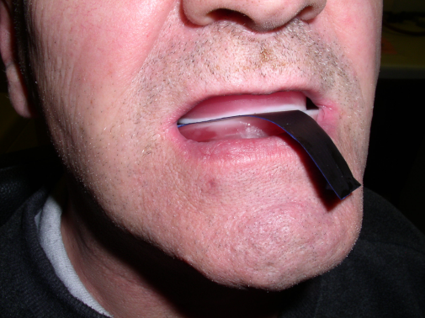
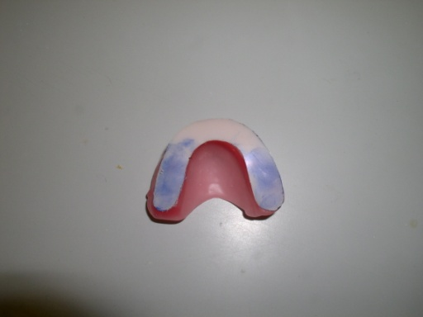
CLINICAL PROCEDURE
Visit 3
Dynamic Bite Registration
The lab will send you the dynamic bite registration rims. These are placed into the patient’s mouth and are then customised to the patient’s individual functional movements.
Check that the occlusion of the rims is correct, the occlusal plane line is also correct and you are happy with the vertical dimension. Ask the patient to practice the dynamic movements. If all is correct you then proceed, Remember: you cannot proceed if any of those three things are not right. You then remove 2mm of acrylic from the thickness of the anterior section of the upper occlusal plate. Place the articulating papers between the occlusal plates so that the ink will mark the upper plate first and ask the patient to grind from side to side.
(Fig 15 & 16)
Fig 15
Remove quite vigorously any ink that is on the anterior region of the upper occlusal plate. Do not touch the lower anterior region, because this will represent the occlusal plane line for the setting up stage. Gently remove any ink in the posterior regions of the block. ( a silicone rubber cone maybe the best option) The process is repeated on the lower plate next, followed by the upper, and so on.
At the end of the Dynamic Bite Stage, the aim is to have no ink traces seen in the anterior region during movement (therefore no anterior interferences). When adjusting, remove the ink area only. This an important point to remember because the blue is an indication of the high spots that the occlusal movement is creating.
The time you stop adjusting is when you observe that on the last marking of either plate that there is no ink anteriorly and you have a good covering over the majority of the posterior region. This will coincide with the visual confirmation that when the occlusal plates are in function, they are moving perfectly smoothly and that there is no displacement of either block . The visual check for stability is as important as the ink markings. (Fig 17)
Fig 16
Fig 17

Slide 9
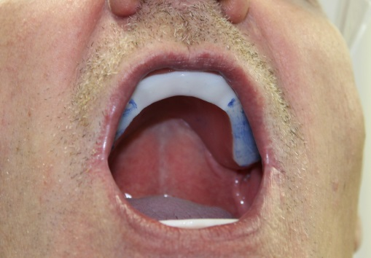
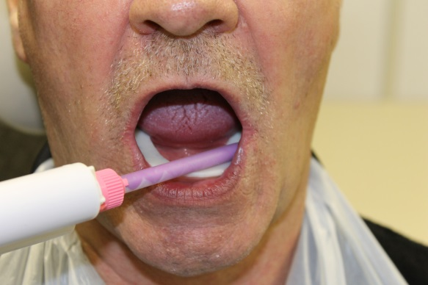
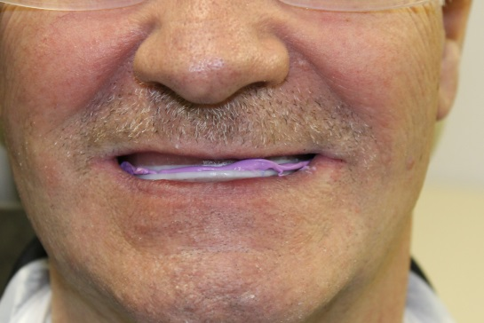
CLINICAL PROCEDURE
Once the Dynamic Bite has been recorded, you are free to add wax for plumping and any other aesthetic indications you wish to make (such as smile line etc). Indicate the midline and canine positions on the upper block in the usual way. You will notice in (Fig 18) the upper anterior region has been removed. This is not needed as we only want to record the posterior tooth area guidance.
The next step is to secure the plates together. This is done by using bite registration material.
Fig 18
Bite registration paste is placed into the lower dynamic plate (Fig 19)
Fig 19
The patient is encouraged to go to their centric neuromuscular position as they close the blocks together. The blocks are removed and returned to the laboratory. (Fig 20)
Fig 20
Visit 4
The lab will send you a wax try on which you will be able to further refine the dynamic bite ,to ensure the upper and lower dentures are stable in functional movements. Remember to conduct all of the normal checks with a wax try stage (appearance etc)
Visit 5
Fit the dentures and refine the bite further if necessary.

Slide 10
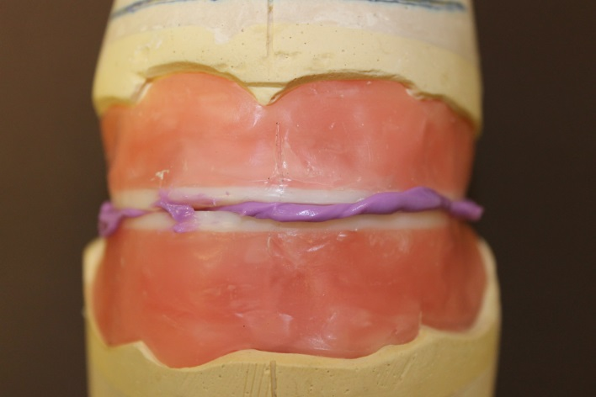
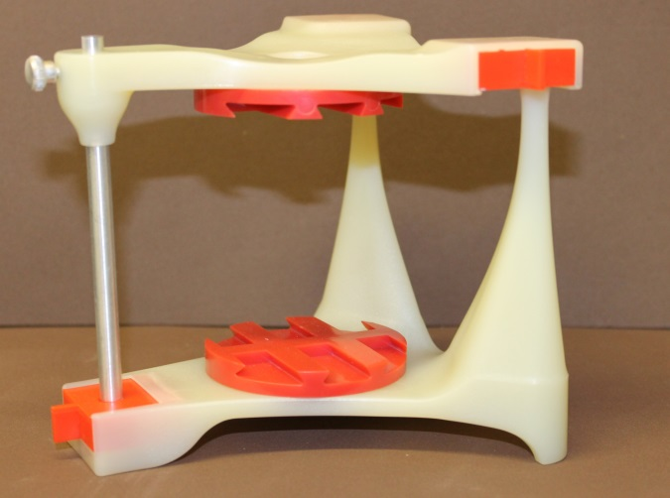
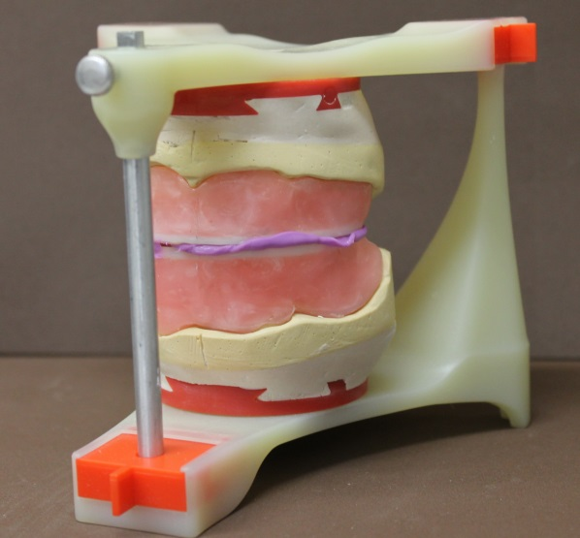
LABORATORY PROCEDURES
The dynamic plates are returned to the laboratory facilities sealed together this time with a bite registration material. (Fig 21)
Fig 21
The Condor articulator with the red boxes in place to give a reproducible starting position. Plus its red mounting plates. (Fig 22)
Fig 22
Dynamic plates and rims are articulated making sure that they are central to the Condor and the occlusal plane line is roughly parallel to the Condor ‘s upper and lower bases. (Fig 23)
Fig 23

Slide 11
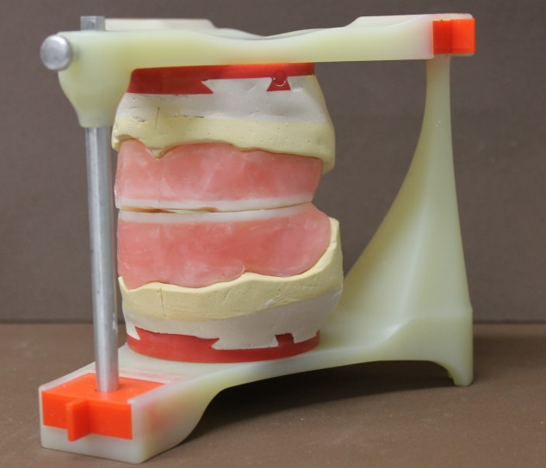
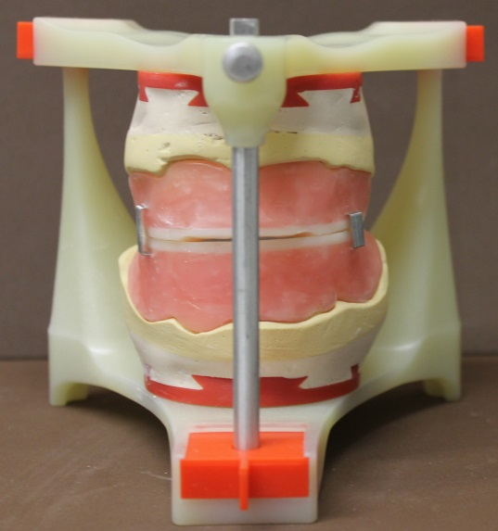
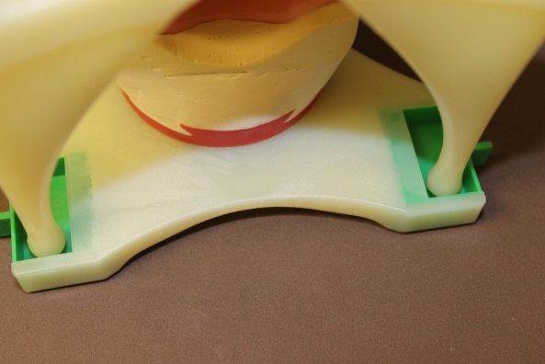
LABORATORY PROCEDURES
The bite registration material is removed. (fig 24). You will be able at this stage to check that you have recorded the bite correctly, as the posterior parts of the upper and lower plates should be accurately fitting each other.
Fig 24
Before the generating of the patients functional movements onto the Condor a method of retaining the neuromuscular bite position recorded when the bite registration material has been removed must be attained. This is done with the use of staples, keeping the rims together. (Fig 25)
Fig 25
All the red boxes are removed and green ones are put into their place. (Fig 26)
Fig 26

Slide 12
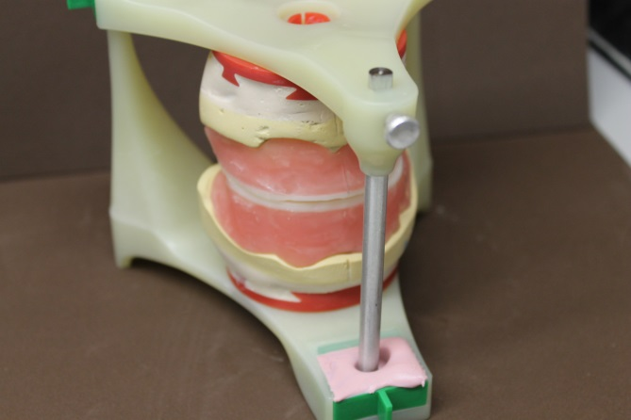
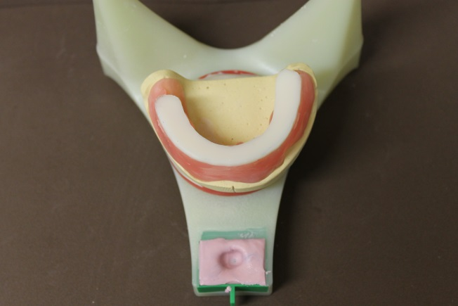
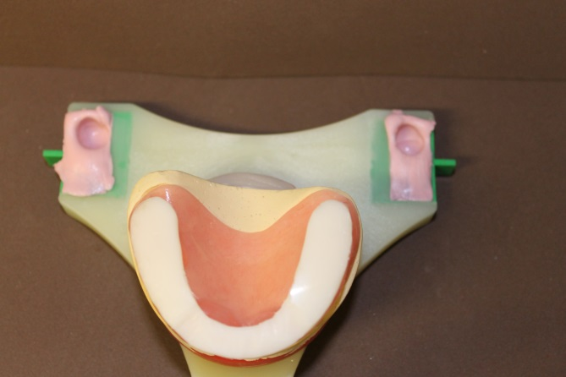
LABORATORY PROCEDURES
Laboratory putty or an epoxy resin is put into the green boxes, the staples removed and the patients dynamic function is transferred to the Condor, as shown and practiced on the CQR training course. (Fig 27)
Fig 27
(Figs 28 & 29) show the recordings of the patients dynamic movements now programmed into the Condor. You do not want to see the base of the green boxes coming through.
Fig 28
Fig 29

Slide 13
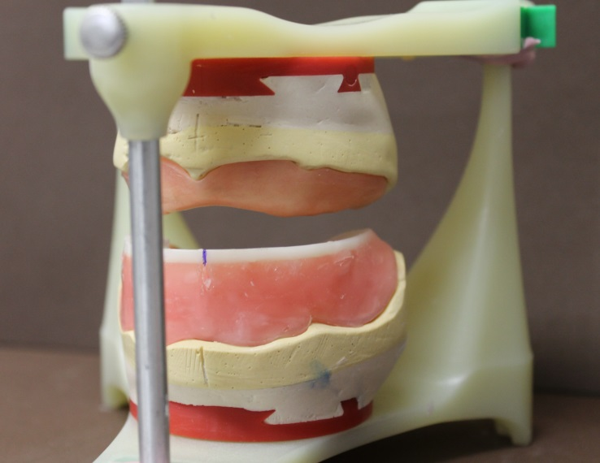
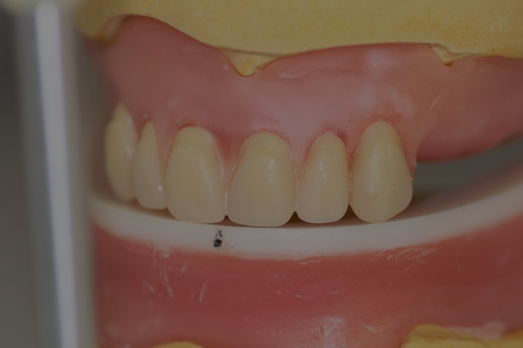
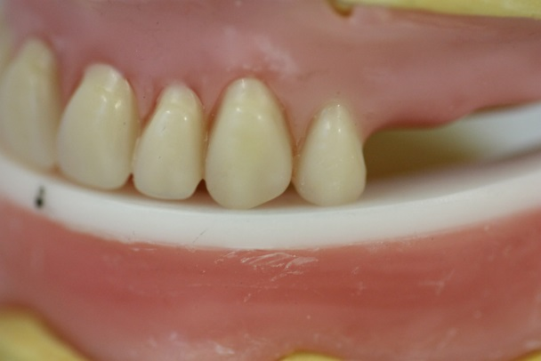
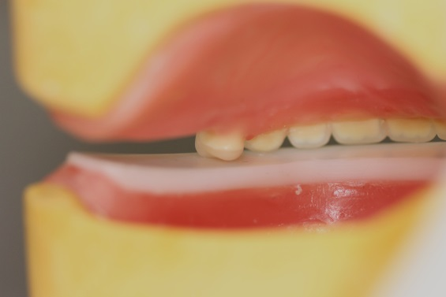
LABORATORY PROCEDURES
The next stage is to remove the upper dynamic rim and replace it with an acrylic base plate. Before this however the upper centre line is transferred to the lower occlusal plate, so to give the indication where the upper anterior centrals need to go. (marked in blue) (Fig 30) It must be stated with all the following illustrations that all other types of manufactured teeth are acceptable , though it must be noted that the flatter cusp the more efficient the masticatory function of the patient. This is shown in the anthropological records. For the setting up all of the upper posterior and anterior teeth it is recommended to put the red boxes back into position so to set the teeth up in a static position to start with.
Fig 30
The upper anteriors are set up using the lower anterior part of the lower occlusal plate. This part of the lower occlusal plate has not been touched during the grinding in process for the dynamic bite and is there to represent the upper occlusal plane line. (Fig 31)
(Fig 32) shows the setting up of the first premolar. No preference is given by CQR on what posterior teeth to be used. The first premolar in all makes of teeth have a design flaw for the CQR technique. Because all manufactured teeth are made to accommodate the symmetrical curves of Spee & Wilson, whereas in reality natures compensating curves are asymmetrical. What this means for the first premolar is that if you try to get both cusps to fit onto the occluding plate the neck of the tooth will be in standing and will give uneven appearance from the frontal view. Therefore the palatal cusp is sacrificed and only the buccal cusp will touch the plate. This will not effect the overall function of the dentures.
Fig 31
Fig 32

Slide 14
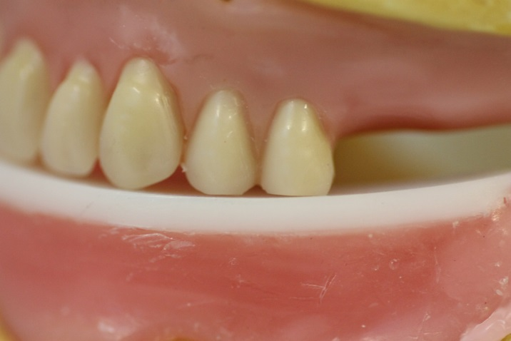
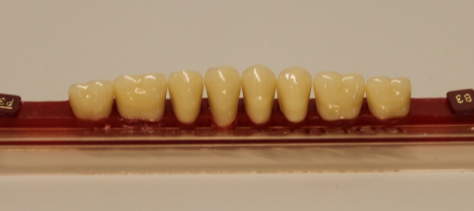
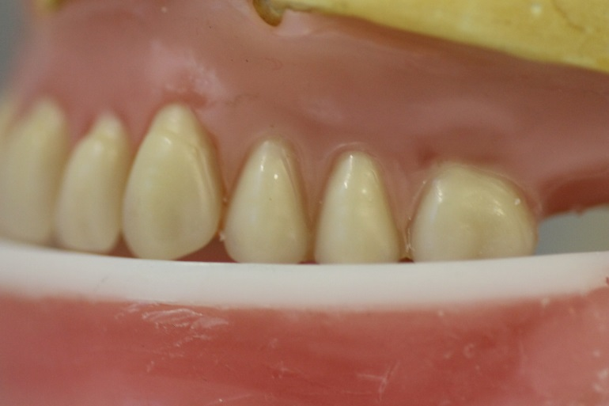
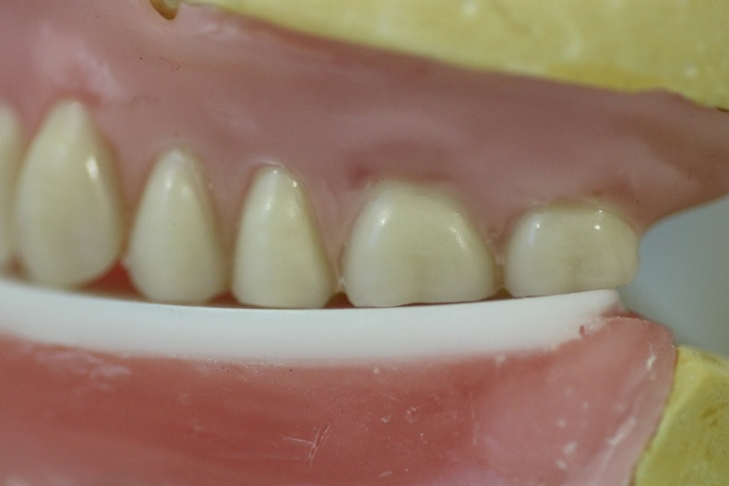
LABORATORY PROCEDURES
The second premolar before being placed has its two cusps flatten. (Fig 33)
Fig 33
Do not be afraid to flatten the cusps!
The technique for tooth adjustment is the same for the first molar, except it has four cusps that are adjusted.
Fig 34
For the second molar the process is the same. (Fig 35). It is desirable with this technique to put the second molar on as it will aid the function, but common-sense has to prevail and if there is not enough room it can be left off. If the plate is short and yet you can put the 2nd molar on, then the tooth position is estimated for its position and will be adjusted at the try-in stage when the patients function is tested.
Fig 35

Slide 15
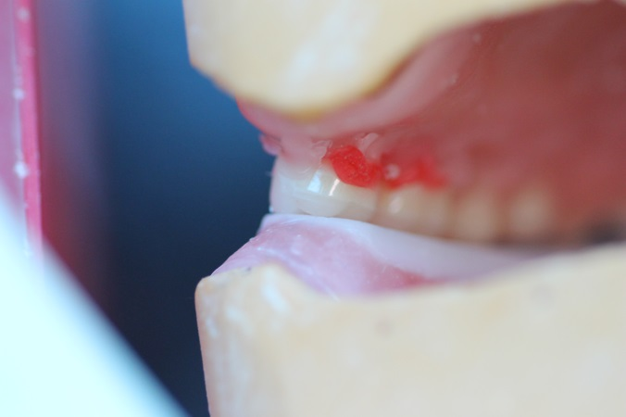
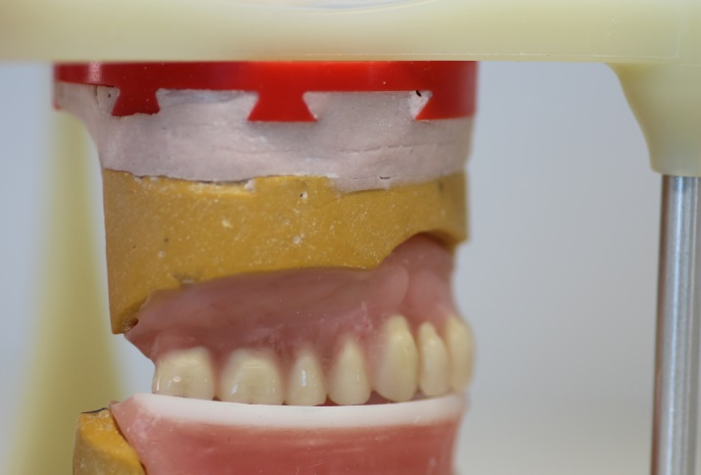
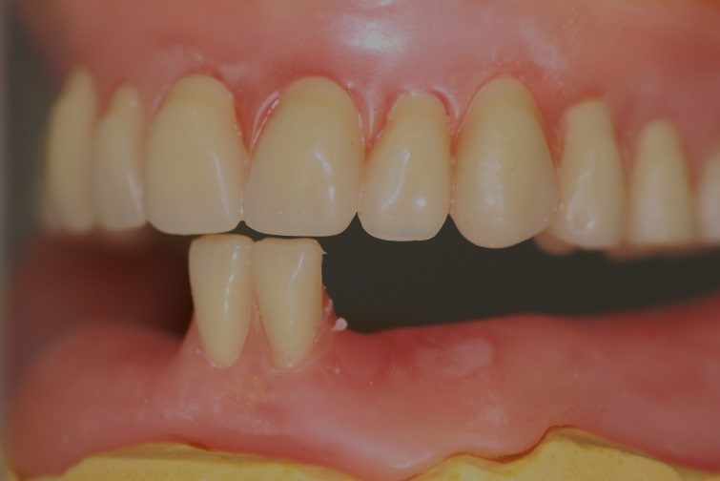
LABORATORY PROCEDURES
You make sure all the flatten cusps are accurately touching the lower occlusal plate, except the palatal cusp of the first premolar. (Fig 36)
Fig 36
The patients right side is set up using the exact same principles. (Fig 37)
Fig 37
Still keeping the red boxes in, set up the lower two central incisors. This is to help get the correct alignment of the upper and lower centre lines. This is an estimated position and will be tested when the green boxes are replaced. Try to set them with a very small negative over bite, so to allow for the compression of the patients tissues and the flex of the mandible. (Fig 38)
Fig 38

Slide 16
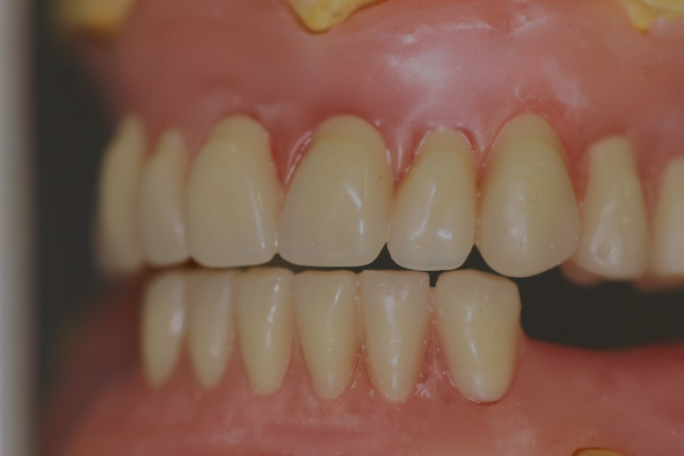
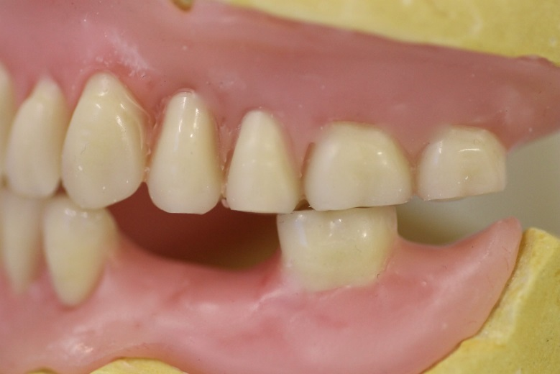
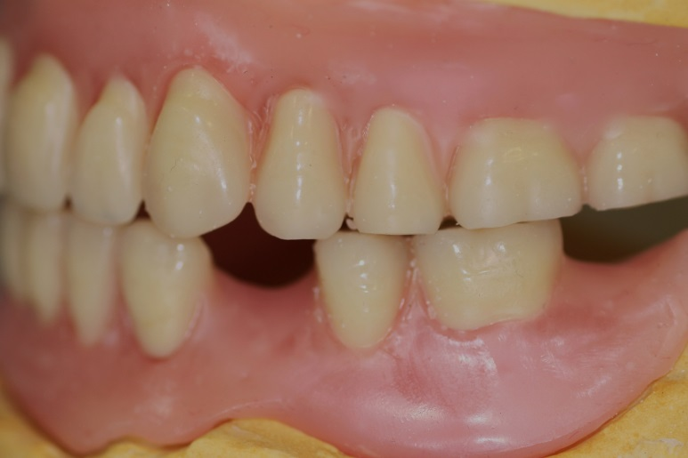
LABORATORY PROCEDURES
Now is the time to remove the red boxes and replace them with the green. The dynamism of the Condor now comes into play with the setting up of the lower anteriors. The teeth have to be positioned so that there is no anterior tooth contact during lateral excursions.(Fig 39)
Fig 39
The first molar is set up first in this instance. This is only demonstrating a preference, there is no right or wrong on the order of setting the lower posteriors up. (Fig 40)
Fig 40
The second premolar is then set up, making sure there is good flatten cusp to flatten cusp contact. (Fig 41)
Fig 41

Slide 17
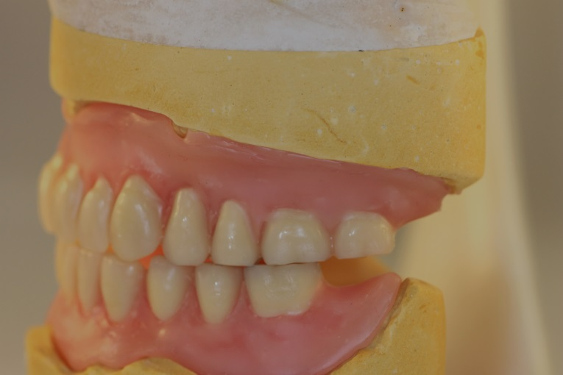
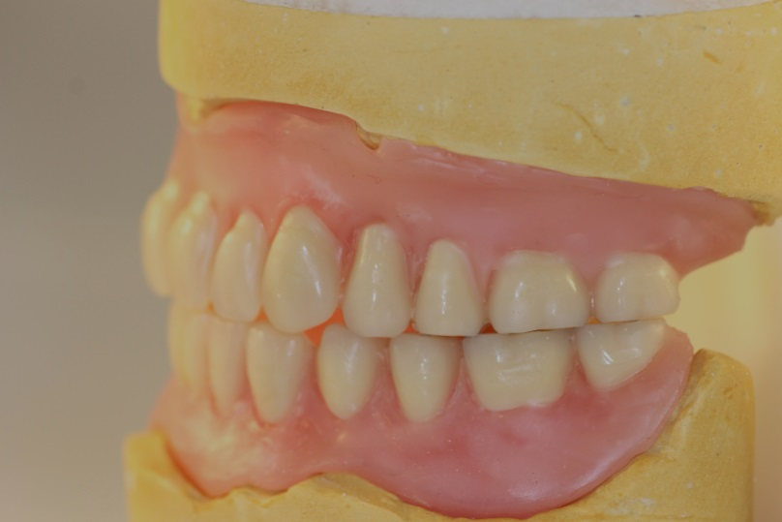
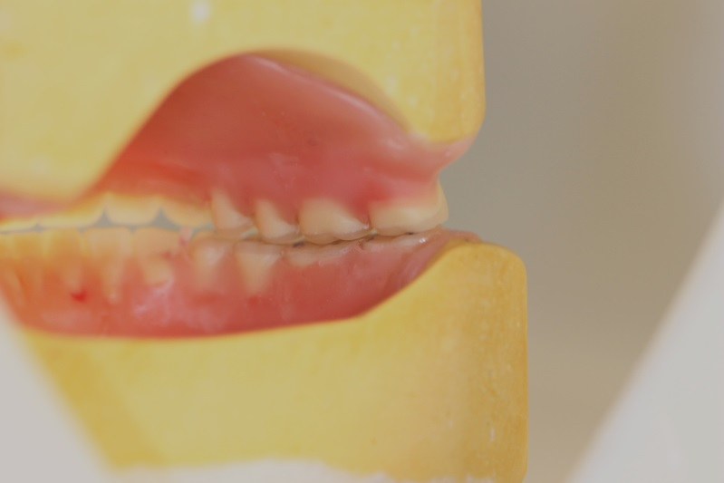
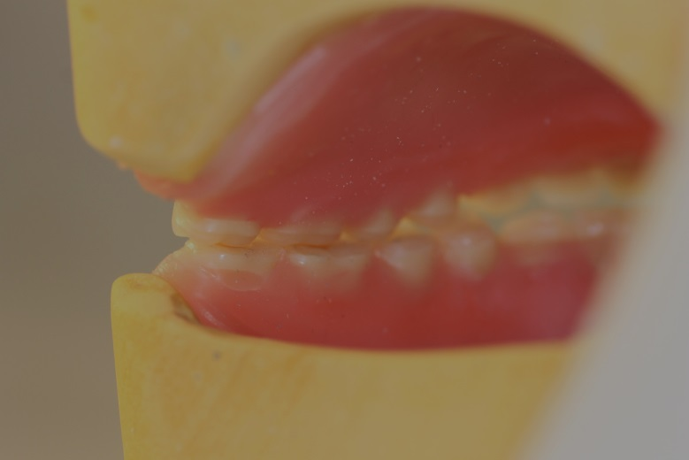
LABORATORY PROCEDURES
The procedure for the first molar is the same as the second premolar, except you only need to adjust the buccal cusp ( the same as the upper tooth), resulting in only one point contact of both these occluding teeth. (Fig 42)
Fig 42
The second molar is now put into position. (Fig 43)
Fig 43
(Fig 44) showing the lingual/palatal view of the set up..
Fig 44

Slide 18
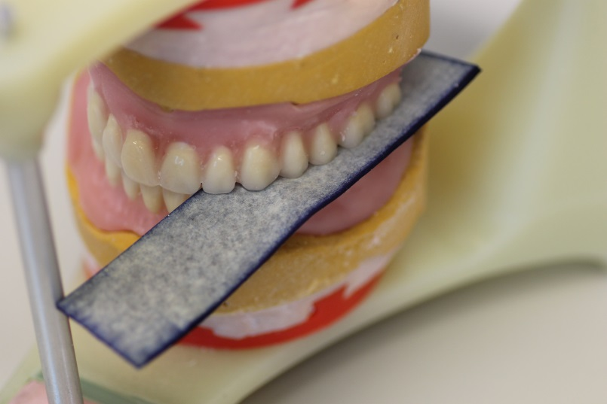
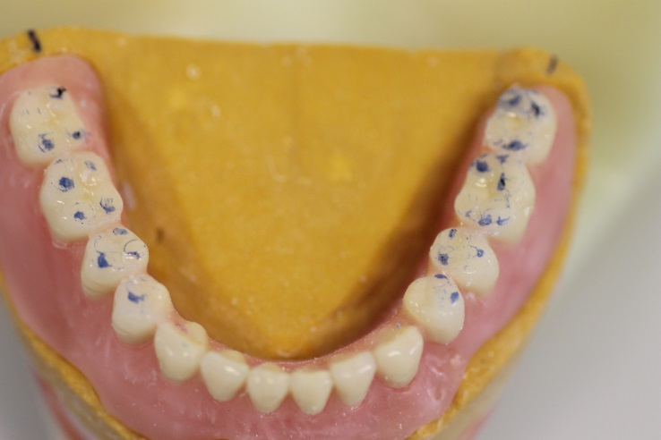
LABORATORY PROCEDURES
Articulating paper is place between the posterior teeth on both sides and with a slight pressure is exerted to mark up the contact points of the teeth when in dynamic function. (Fig 45)
Fig 45
If there are good contacts on all the teeth it is ready for waxing up ready for the try-in. (Fig 46)
Fig 46
The try-in can now be prepared for the try-in stage. This were firstly you check the appearance and vertical dimension to be acceptable to you and the patient. The functional movements should be smooth and further adjustment is OK at this stage, using single sided articulating paper. It would probably be best to make most of the occlusal adjustments on the lower teeth. Holding the patients masseter and temporalis muscles and feeling for any interferences is a good procedure, as well as asking the patient. It is recommended that you do a final bite check at the try-in even if it seems everything is Ok, as this gives you the ability to put it back on a simple hinge articulator to see if the occlusion is light anywhere. Final adjustments are recommended at the insertion and review appointments.

